Slide 1
Photo Report
Organization name:
Country:
Date of submission:

Slide 2
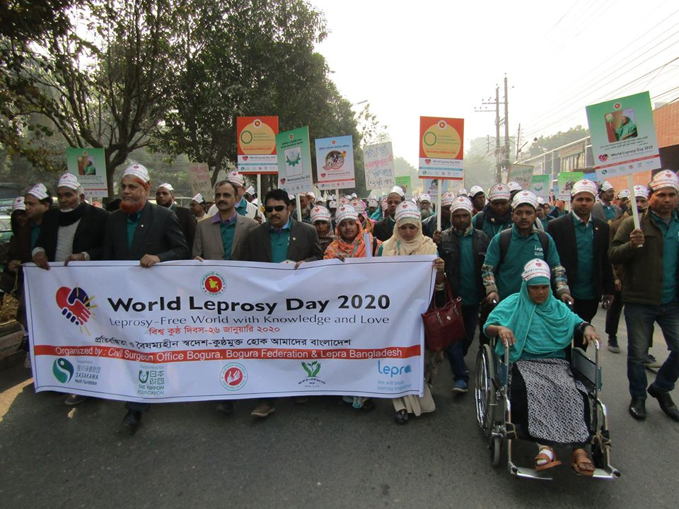
Photo report
Please select and report on up to 10 most memorable photos during the project period. Please include a title, the place where the photo was taken, the date it was taken and a short description of the photo.
Title: Rally and Campaign for WLD 2020
Place: Bogra district, Bangladesh
Date: 28 January 2020
Short description:
Rally started at 9:30 am from the 250 bedded Mohammad Ali Hospital to Civil Surgeon office, Bogura. Honorable Civil Surgeon, Dr. Md. Gawsul Azim Chowdhury lead the rally. Around 250 people participated in the rally among them 90 were people affected by leprosy and their organizations call federation and self help groups, 80 government health staffs , 23 students from nursing institute , 20 other health related NGO representative, 27 Lepta staffs and volunteers, reporters and others 10.

Slide 3
Photo report 1/10
Photo here!
Title:
Place:
Date:
Short description:

Slide 4
Photo report 2/10
Photo here!
Title:
Place:
Date:
Short description:

Slide 5
Photo report 3/10
Photo here!
Title:
Place:
Date:
Short description:

Slide 6
Photo report 4/10
Photo here!
Title:
Place:
Date:
Short description:

Slide 7
Photo report 5/10
Photo here!
Title:
Place:
Date:
Short description:

Slide 8
Photo report 6/10
Photo here!
Title:
Place:
Date:
Short description:

Slide 9
Photo report 7/10
Photo here!
Title:
Place:
Date:
Short description:

Slide 10
Photo report 8/10
Photo here!
Title:
Place:
Date:
Short description:

Slide 11
Photo report 9/10
Photo here!
Title:
Place:
Date:
Short description:

Slide 12
Photo report 10/10
Photo here!
Title:
Place:
Date:
Short description:

